Slide 1


CyberSHE: Protecting Women’s Privacy and Security in Cyberspace
RINITA SARKAR
ABHISHEK CHOUDHARY

Slide 2

PROBLEM STATEMENT
In today’s interconnected world, digital safety is a crucial aspect of overall security, and it affects women in urban areas just as much as physical safety.
Cyber violence against women and girls is a global human rights violation that affects millions of women and girls
Committed, assisted or aggravated by the use of ICTs, such as internet, social media, mobile phones, email, etc.
Includes cyberstalking, harassment, bullying, hate speech, threats, blackmail, pornography, and exploitation
Impacts physical, psychological, social and economic well-being of victims/survivors
Requires urgent attention and action from all stakeholders

Slide 3


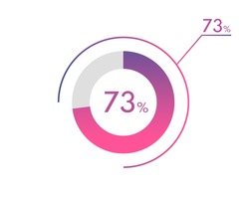


Present situation
Women between the ages of 18 and 24 are at the highest risk of being targeted by cyber violence.
Women are 27 times more likely to be harassed online than men.
Around 73% of women and girls have experienced some form of online violence or abuse
One in five female internet users live in countries where cyber harassment is extremely likely to go unpunished.
Only 26% of law enforcement agencies in the 86 countries surveyed are taking appropriate action against cyber violence.
Source: Report by the United Nations Broadband Commission for Digital Development
Notes:
According to a report by the United Nations Broadband Commission for Digital Development

Slide 4

PROPOSED Solution
CYBERSHE is a one stop solution for protecting women’s privacy and security in cyberspace.
It is an AI-based system that can be integrated with third party applications or OS to safeguard women against cyber violence such as harassment, bullying, hate speech, threats, blackmail, misuse of images, and exploitation etc.
Designed to be simple and easy to use, and it can be customized according to the user’s preferences.
Three major features:
Image protection
Filtering inappropriate content
Access to support services
CYBERSHE is an useful app for women who want to feel more secure and confident in cyberspace.

Slide 5
FEATURES & Technology
Image protection (Protection against threat, blackmail & exploitation)
Use Case: Upload or import your images and videos. It will Scan the web and find any unauthorized use of your content Dashboard will give result to take actions. | AI techniques : Reverse image search (Leveraging built-in feature already present in MS Edge) Image hashing algorithm such as Phash3 and Block Hash (MS PhotoDNA technology) Machine learning models
Filter/Block inappropriate messages/comments (Protection against bullying and hate speech)
Use Case: Detect and flag abusive, hateful content such as messages, comments, posts or images. Filter out harmful content | AI techniques: Natural Language Processing (NLP) Keyword filtering Supervised machine learning models & algorithm
Access to support services (To build a community & take appropriate actions against cyber violence)
Use Case: Access to helplines & crisis centers Access to legal assistance for reporting Access to Law enforcement | AI techniques: Virtual assistants & Natural Language Processing (NLP) Data analytics Generative AI

Slide 6

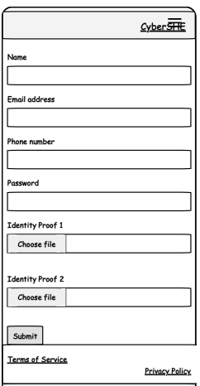
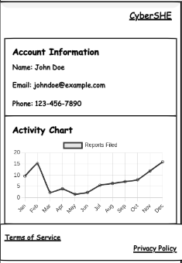
Design MOCKUP
Profile Creation Screen

Slide 7
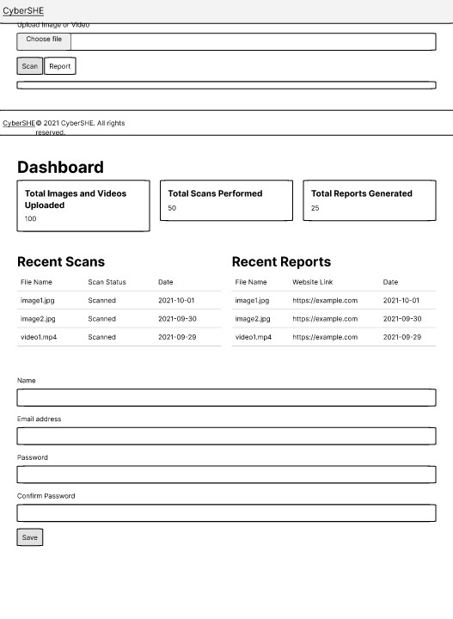
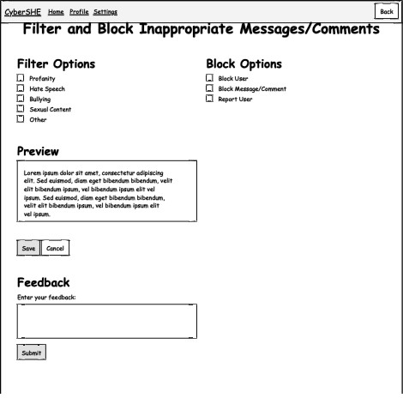
DESIGN MOCKUP
Image Protection Screen
Scan Messages Screen

Slide 8
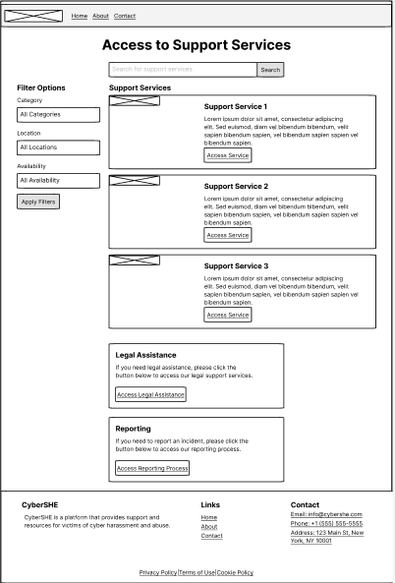
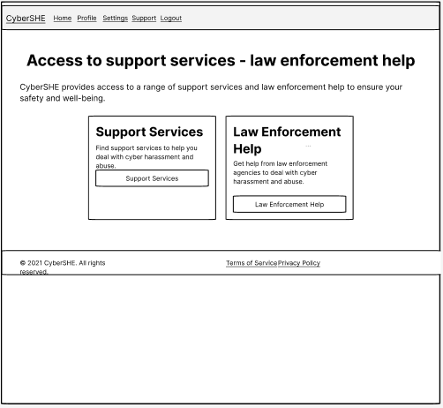
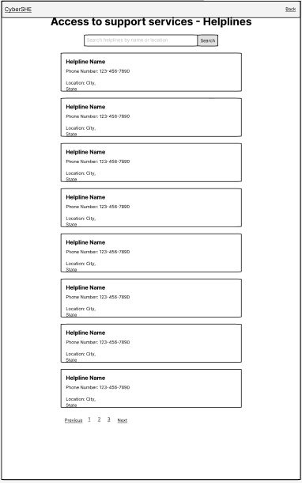
DESIGN MOCKUP
Access to Support Services Screens

Slide 9
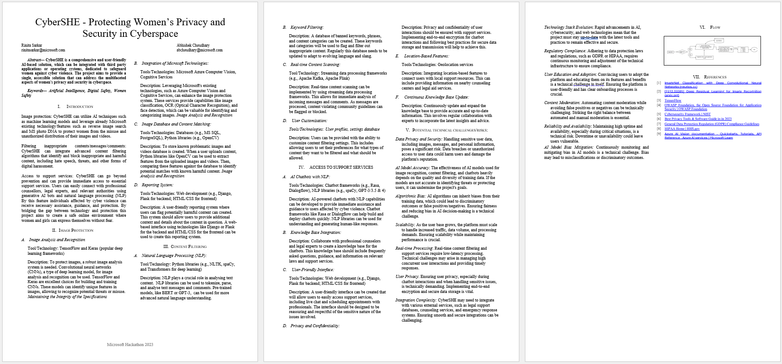
Research paper
Link: https://github.com/RinitaSarkar/CyberSHE

Slide 10
PROPOSED value
FOR CUSTOMERS
FOR MICROSOFT
Sense of security and confidence
Integration with Microsoft’s operating system
Empowering women to assert their rights and seek justice
Showcases Innovation and leadership in developing cutting-edge technologies
Safeguard from cyber violence
Integration with third party apps to enhance privacy and security
Sense of community and solidarity
Demonstrates Microsoft’s social responsibility to address global issues

Slide 11

“We’re changing the world with technology” ~ Bill Gates

